Slide 1
Unit3 Teenagers should be allowed to choose their own clothes.
（查查吧 www.chachaba.com提供，欢迎关注我们）

Slide 2
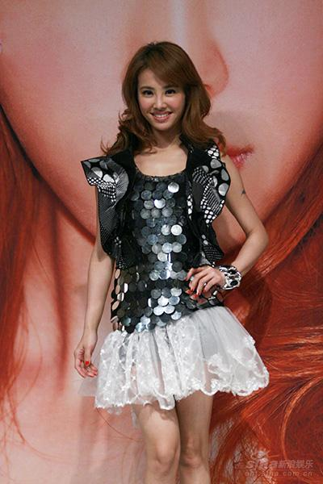
She gets her hair dyed.
Are you allowed to wear a mini skirt?
Are you allowed to dress in this way?
Are you allowed to get your hair dyed?
She wears a mini skirt.

Slide 3
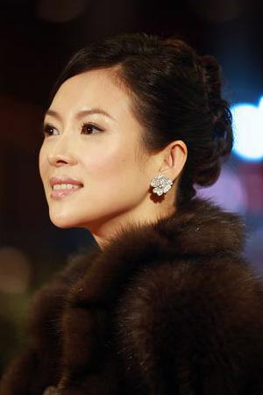
She wears a pair of ear rings
She gets her ears pierced.
Are you allowed to wear ear rings?
Are you allowed to get your ears pierced?

Slide 4
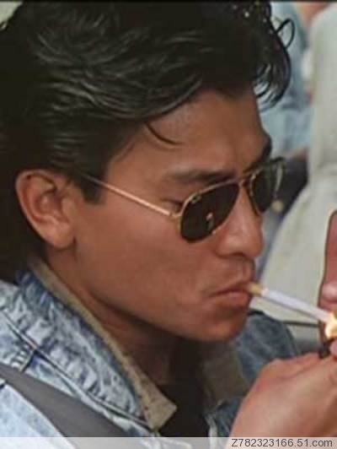
Should we be allowed to wear sunglasses?
Yes, we should.
Should we be allowed to smoke?
No, we shouldn’t.

Slide 5
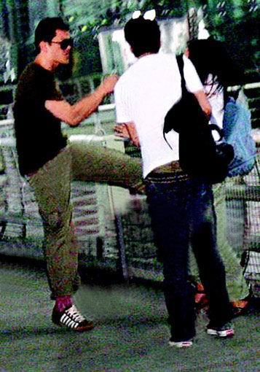
Do you think we should be allowed to fight with others?
No, I don’t.

Slide 6
Make up a short dialogue with your partner using “ Should we be allowed to …/ Do you think we should be allowed to..”
Cut in line, eat in the street, drop litter everywhere, speak loudly in public, cheat in exams, sit on special seats, cross the street without walking on the zebra stripe, have a part-time job, hang out with friends

Slide 7

1. When do you have to get up every morning?
2. You are allowed to meet your friends after school, aren’t you?
3. Can you watch TV on school nights?
4. What can you do on weekends?
5. Can you choose your own clothes?

Slide 8
What rules do you have at home?
Ask your partner about their rules at home and report like this :
My partner is allowed to …. And he / she is not allowed to …

Slide 9
Sun Fei
Wu Yu
Don’t go out on school nights.
Don’t go out on school nights.
Study at a friend’s house.
Go to the movies with friends on Friday nights.
Go the movies with friends on Friday nights.
Go shopping with friends on Saturday afternoons.
Have to be home on school nights.
Choose your own clothes.
Don’t get your ears pierced.

Slide 10
What do you think parents should / shouldn’t do at home?
smoke / drink / play cards / cook for children / beat children / scold children / scold children in public / wash the clothes for children / read children’s diary without permission / buy children what they want / break their word / play computer games

Slide 11
被动语态
语态分为两种，即主动语态和被动语态。
主动语态表示主语是动作的发出者，而被动语态表示主语是动作的承受者。
be+及物动词的过去分词。
be有人称、时态和数的变化。

Slide 12
把下列句子改成被动语态
They allow us to have part-time jobs.
____________________________________.
2. The teacher asked Anna to finish the picture.
____________________________________.
3. People in the UK speak English. ____________________________________.
4. We must send the postcard at once.
_____________________________________.
We are allowed to have part-time jobs
Anna was asked to finish the picture
English is spoken in the UK.
The postcard must be sent at once.

Slide 13
5. The old cat has eaten the fish.
___________________________________.
6. I can’t find the watch anywhere.
____________________________________.
7. When will you work out the math problem?
_____________________________________
———————————————————.
8. Where have you put my backpack? ____________________________________.
The fish has been eaten ( by the old cat ).
The watch can’t be found anywhere.
When will the math problem be worked out?
Where has my backpack been put?

Slide 15
1. David broke the cup.
The cup was broken by David.
2. A thief has stolen my keys.
My keys have been stolen.
3. They can take good care of my child.
My child can be taken good care of.
4. They will not clean the office.
The office will not be cleaned.

Slide 16
5. They haven’t told me about it.
I haven’t been told about it..
6. The workers are repairing my car now.
My car is being repaired now.
7. He gave me a book.
I was given a book.
A book was given to me.
8. I saw him cleaning the room.
He was seen cleaning the room.

Slide 17
 | always | sometimes | never
Fight
Talk in class
Sleep in class
Copy homework
Get to school late
Eat snacks in class
Do not wear uniforms

Slide 18
Read the passage in 3a and answer the questions:
What problems do they talk about?
School uniforms, study in groups and vacations.
2. What does the writer think of them?

Slide 19
1) What does the writer think of uniform?
2) What does the writer think of studying in groups?
He / she thinks the uniforms are ugly and they want to design their own uniforms.
He / she thinks they should be allowed to do so, because they can learn a lot from each other though they get noisy sometimes.

Slide 20
3) What does the writer think of vacations?
The vacations are too short and they can be longer.

Slide 21
The other day
Keep … happy
In groups
Learn from
At present
Have an opportunity to do sth.
前几天
让…快乐
以小组的形式
向…学习
目前，眼下，现在
有机会做某事

Slide 22
My friends and I talked about the rules that we have in school.
定语从句
The problem is that all my classmates think the uniforms are ugly.
宾语从句
表语从句

Slide 23
Our teacher believe
that if we did that,
we would concentrate
more on our clothes than our studies.
虚拟语气
concentrate … on
more …than
宾语从句
条件状语从句

Slide 24
Read the passage in Self check 2 and underline the statements.
1. We should be allowed to take time to do things like that more often.
2. We should visit primary schools and help teach young students.
3. We should be allowed to volunteer at newspaper office once a week.
4. Some students should be allowed to have Friday afternoons off to volunteer and help others.

Slide 25
Dear Editor，
I would like to reply to the article. I agree with most of your ideas. The article said that students should be allowed to take time to visit the old people and primary schools. I quite agree with you about this because they can be very good experiences. As for having Friday afternoons off, I think it’s not necessary for most students, because we have two-day weekends.
…

Slide 27
Do you have any hobbies?
If yes, what are they?
Do your parents allow you to have them?
If not, what will you do?

Slide 28
Read the passage and answer the two questions:
1. What does Liu Yu want to be?
2. Do his parents agree with his decision?
3. What do his parents think of it?
4. What about Liu Yu?

Slide 29
1. Our sun needs to be realistic.
2. He needs to think about what will happen if he doesn’t become a professional runner in the end.
3. Very few people can become professional athletes.
4. He needs to spend time on his homework.

Slide 30
I should be allowed to make decisions for myself.
2. I’m serious about running.
3. I will succeed.
（查查吧 www.chachaba.com提供，欢迎关注我们）

Slide 31
Read the passage and complete the chart.
Parents’ points | Liu Yu’s points
Worry about his _______ | Wants to be a ________________.
Think he should time on _________. | Just wants to do what he _________ .
Think he needs to be _________. | Be serious about _______.
Think it is a very difficult dream to _______. | ________ himself.
success
professional runner
study
enjoys
realistic
running
Believe
achieve

Slide 32
1.We have nothing against running.
我们没有理由反对他跑步
2. But we do think that our son needs to be realistic.
对动词进行强调
（查查吧 www.chachaba.com提供，欢迎关注我们）

Slide 33
3. But I’m serious about running.
Be serious about: 对…非常热衷。
4. Being a professional runner is the only thing I have ever wanted to do.
定语从句
（查查吧 www.chachaba.com提供，欢迎关注我们）

Slide 34
5. It’s a very difficult dream to achieve.
这个梦想很难实现。/ 这是一个很难实现的梦想。
6. Only then will I have a chance of achieving my dream.
只有那样我才有实现梦想的机会。
倒装句
Only in this way can we learn English well.
（查查吧 www.chachaba.com提供，欢迎关注我们）

